Slide 1

7th Grade Math
Unit 4, Lesson 5 Exploring Relationships in Circles Volume 1, pg. 148

Slide 2


Benchmark
MA.7.GR.1.3
Explore the proportional relationship between circumferences and diameters of circles. Apply a formula for the circumference of a circle to solve mathematical and real-world problems.
volume 1, pg. 148

Slide 3
Integrated Mathematical Thinking and Reasoning Standards
MA.K12.MTR.1.1 Actively participate in effortful learning both individually and collectively.
MA.K12.MTR.4.1 Engage in discussions that reflect on the mathematical thinking of self and others.
MA.K12.MTR.5.1 Use patterns and structure to help understand and connect mathematical concepts.
MA.K12.MTR.6.1 Assess the reasonableness of solutions.
MA.K12.MTR.7.1 Apply mathematics to real-world contexts.
volume 1, pg. 148

Slide 4

Learning Target
I can explain the relationship between the circumference and diameter of a circle.
volume 1, pg. 148

Slide 5

Warm-Up
volume 1, pg. 148

Slide 6
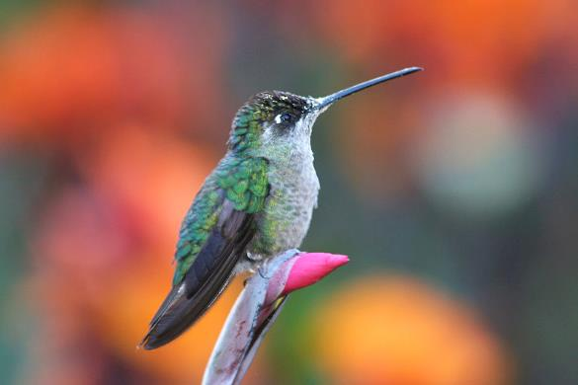
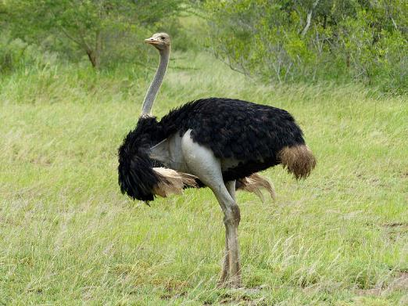
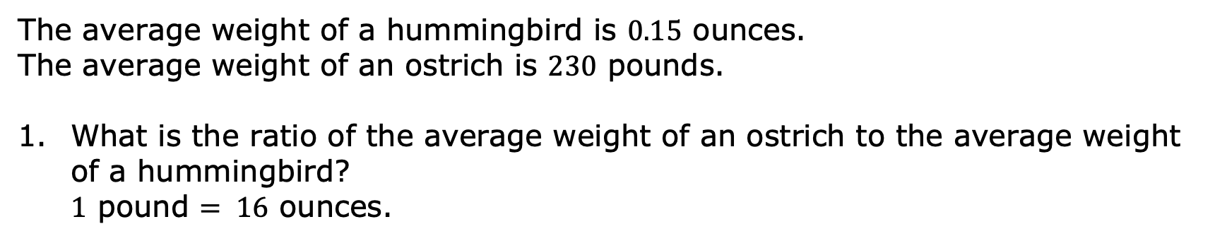
4.5.1 Warm-Up: Ostrich vs. Hummingbird
The average weight of a hummingbird is $0.15$ ounces. The average weight of an ostrich is $230$ pounds.
What is the ratio of the average weight of an ostrich to the average weight of a hummingbird? $1$ pound $= 16$ ounces.
volume 1, pg. 148
Notes:
Video Link: https://algebranation.wistia.com/medias/fi4fidi5y8

Slide 7

Guided Instruction
volume 1, pg. 149

Slide 8


4.5.2 Guided Instruction: Identifying Parts of a Circle
A circle is a perfectly round two-dimensional figure, where all points on the circle are equidistant from the center.
A circle with center 𝑅 is shown.
volume 1, pg. 149

Slide 9
The purple line segment is a diameter of the circle. The pink line segment is the radius of the circle. The center of a circle is the point that is the same distance from all points on the circle.
The plural of radius is radii. Circles have radii and diameters, both of which pass through the center of the circle.
The green part of the circle is the circumference.
volume 1, pg. 149

Slide 10


Label each part of circle 𝑅 by writing the name of each part.
The length of a diameter is equal to the length of $2$ radii.
A radius is a line segment extending from the center of a circle to a point on the circle.
A diameter is a line segment from any point on the circle passing through the center to another point on the circle.
The circumference is the distance around a circle.
volume 1, pg. 149

Slide 11
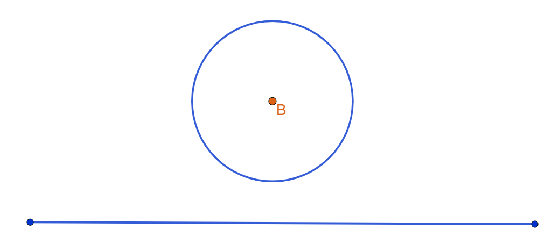
If a circle were made of a piece of string and we cut the string and straightened it out, the circumference would be the length of the string.
Circle 𝐵 is shown.
The line segment is approximately the same length as the circumference of circle 𝐵.
volume 1, pg. 149

Slide 12

Exploration
volume 1, pg. 150

Slide 13

4.5.3 Exploration: Finding Circumference
In the table, record the name of the five different circular objects your group is using.
Using a ruler, measure and record the diameter of each circle in centimeters (cm).
volume 1, pg. 150

Slide 14
Using string, wrap the circular object with string using your finger to mark the circumference of the circle. Straighten out the string and use it to measure the length of the circumference in centimeters (cm) with a ruler. Then, record it in the table.
Object | Diameter | Circumference
volume 1, pg. 150

Slide 15
A coordinate plane is shown with the horizontal axis representing the diameter and the vertical axis representing the circumference.
Circumference (cm)
Diameter (cm)
volume 1, pg. 150

Slide 16
Plot the values for each object on the graph.
Discuss with your partner what you notice about the graph.
volume 1, pg. 150

Slide 17
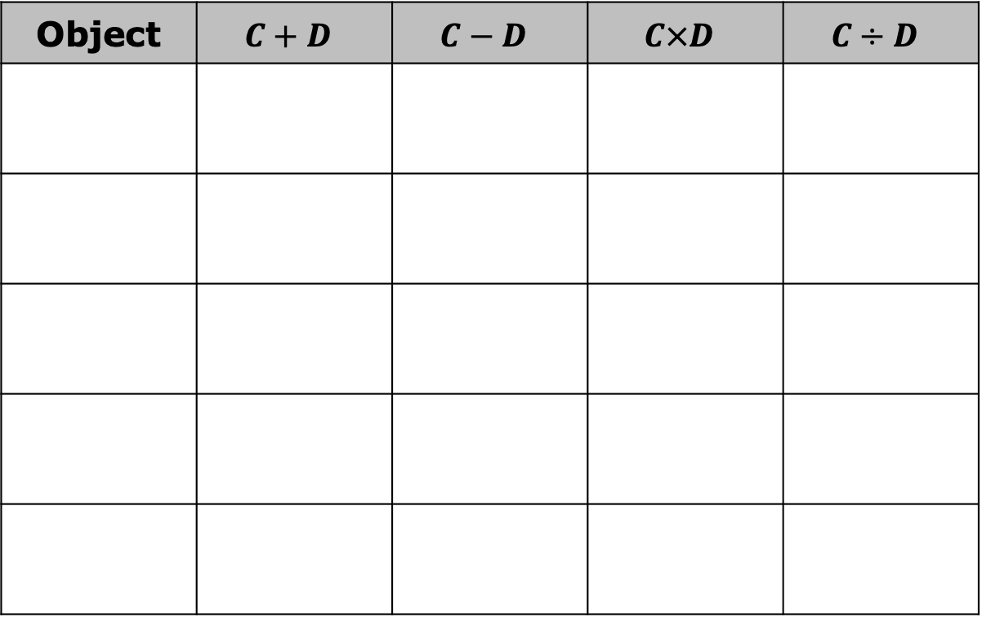
Using circumference (𝐶) and diameter (𝐷), find the value of the expressions listed in the table for each of the circular objects measured.
Object | $$C+D$$ | $$C−D$$ | $$C×D$$ | $$C÷D$$
volume 1, pg. 151

Slide 18
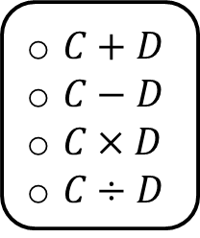
What do you notice about the table?
Use the information in the table to complete the statement. The value of is approximately equivalent for each circular object. It is approximately _______.
$C+D$
$C−D$
$C×D$
$C÷D$
volume 1, pg. 151

Slide 19
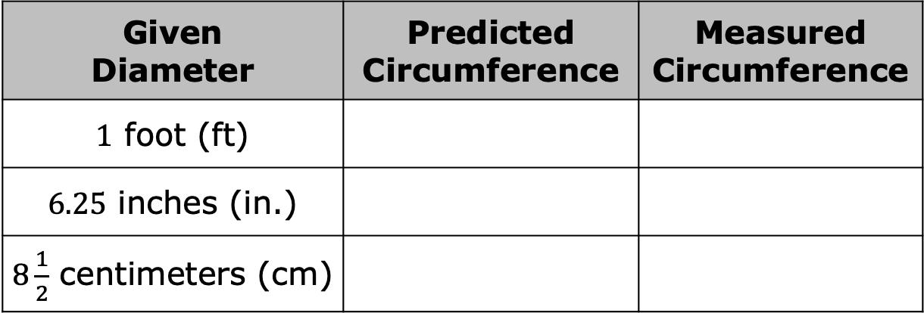
Use the relationship you observed to predict the circumference of each circle using the given diameter. Record your predictions in the middle column.
Use a string and a ruler to measure the circumference of each of the circles using the same units from the given diameter. Then, record the measured circumference of each circle in the table.
Given Diameter | Predicted Circumference | Measured Circumference
$1$ foot (ft)
$6.25$ inches (in.)
$8\frac{1}{2}$ centimeters (cm)
volume 1, pg. 151

Slide 20
Describe the accuracy of your predictions.
volume 1, pg. 151

Slide 21

Wrap-Up
volume 1, pg. 152

Slide 22
4.5.4 Wrap-Up: Cool Down
Write an explanation to a classmate who might have missed today’s lesson, in your own words, about the relationship between the circumference of a circle and its diameter.
volume 1, pg. 152

